Slide 1

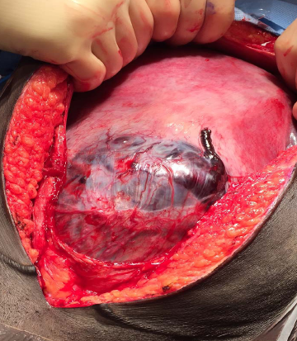
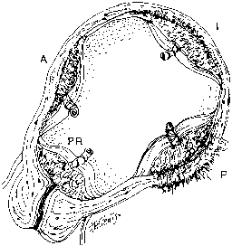
Abnormal Invasive Placenta (AIP)
Muhammad M Al Hennawy
Consultant Obstetrician & Gynacologist
Ras El Bar Central Hospital ,
Dumyat Specialised Hospital ,
Egypt

Slide 2
Definition
Placenta accreta occurs when the placenta does not separate from the myometrium completely or partially
Due to a defect of the decidua basalis,
in conjunction with an imperfect development of the Nitabuch membrane ( a fibrinoid layer that separates the decidua basalis from the placental villi).
Resulting in abnormally invasive implantation of the placenta

Slide 3
First Described
Placenta accreta is a histopathologic term for a condition first described in 1937
By obstetrician Frederick C. Irving
and pathologist Arthur T. Hertig
At the Boston Lying-In Hospital.
Sometimes the placenta doesn’t get the signal to stop growing. It keeps spreading, down and out, through the lining of the uterus.

Slide 4
Why?
Pathogenesis of a 20th century iatrogenic uterine disease
Several concepts have been proposed to explain the abnormal placentation in placenta accreta including
- A primary defect of the trophoblast function,
- A secondary basalis defect due to a failure of normal decidualization and
- More recently an abnormal vascularisation and tissue oxygenation of the scar area

Slide 5
Molecular Circuits Shared by Placental and Cancer Cells
The ability of trophoblast cells to proliferate and then to migrate and invade the uterine wall, as well as the many common characteristics shared by normal trophoblast cells and malignant cells,
Moreover,
Normal trophoblast can be transformed into hydatidiform mole, a highly proliferative benign trophoblastic disease and into choriocarcinoma,

Slide 6
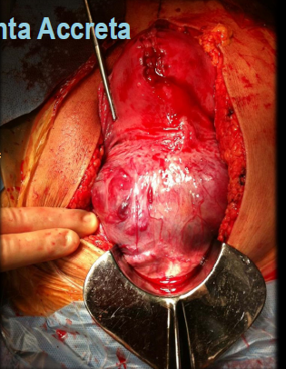
Terminology
placenta accreta spectrum (PAS) disorders
Abnormal Invasive Placenta (AIP)
Morbidly adherent placenta (MAP)
placental adhesive disorders,
abnormally adherent placenta,
abnormal placental adherence,
advanced invasive placentation
Too deeply attached placenta
Placenta Adherens
Placenta accrete syndrome
Placenta Accretum
Placenta Accretus
Placental attachment disorders

Slide 7
Incidence of Placenta Accreta
The incidence of accrete syndromes has increased remarkably, in direct relationship to the increasing cesarean delivery rate.
From 1930 to 1950--one case in 30,000 deliveries.
From 1950 to 1960, one in 19,000, deliveries.
by 1980 to one in 7,000.
The incidence of placenta accreta was estimated in the 1980s to be 1 in 2500 deliveries;
in 2012 the American College of Obstetricians and Gynecologists stated the incidence to be as high as 1 in 533 deliveries.
Currently, the rate is higher

Slide 8
Risk factors
Advanced maternal age,
Smoking,
Recurrent abortions, and
Multiparity,
But the strongest associations are with placenta previa and prior uterine surgery
The frequency of placenta previa is steadily increasing because of increased numbers of cesarean deliveries.
Placenta previa 1:200 pregnancies
Placenta previa accreta - No previous CS 3% - One previous CS 11%
- Two previous CS 40% - ≥3 previous CS >60%

Slide 9
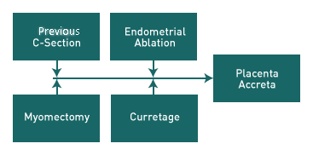
Classification Type of uterine pathologies
Direct surgical scar
Cesarean delivery
Surgical termination of pregnancy
Dilatation and curettage
Myomectomy
Endometrial resection
Asherman’s syndrome
Nonsurgical scar
IVF procedures
Uterine artery embolization
Chemotherapy and radiation
Endometritis
Intra-uterine Device
Manual removal of placenta
Previous accreta
Uterine anomalies
Bicornuate uterus
Adenomyosis
Submucous fibroids
Myotonic dystrophy

Slide 10
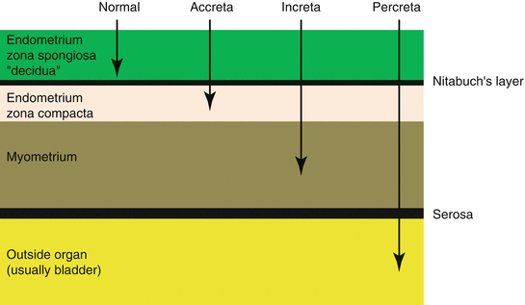
The Degree Of Placental Invasiveness
Again the success rate and outcome of each procedure is directly linked to
in a -depth , b- size and c- site

Slide 11
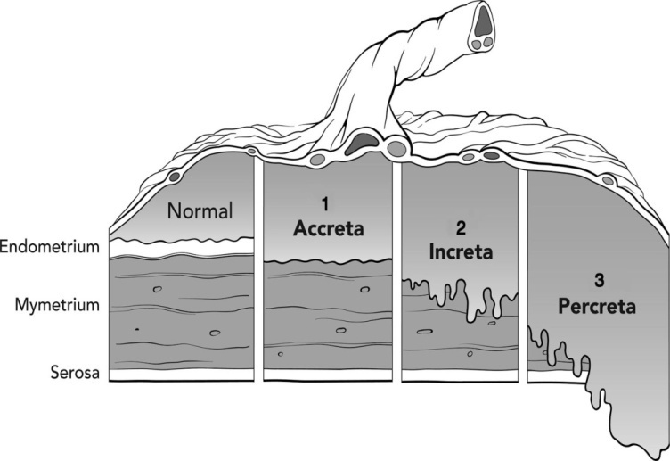
A -Types According Depth
PAS disorders include both abnormally adherent and invasive placentas
(1) adherent placenta 75.8%;, also described by pathologists as “placenta creta, vera or adherenta” when the villi simply adhere to the myometrium;
(2)invasive placenta
(a)placenta increta 17.7%;, when the villi invade the myometrium; and
(b) placenta percreta 6.5%., when villi invade the full thickness of the myometrium including the uterine serosa and sometimes adjacent pelvic organs
however, we will use the term “accreta” to refer to the entire spectrum of an abnormally adherent placenta.

Slide 12
B-Lateral Extension ( Size)
Variations in the lateral extension of myometrial invasion also divide PAS disorders into
the focal PAS,
partial PAS , or
total PAS categories,
Depending on the number of placental cotyledons involved.

Slide 13
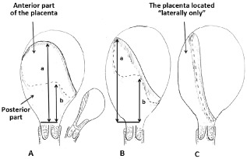
C - Sites of Uterine Invasion
The placenta arises wherever the fertilized egg implants into a woman’s uterus. There are four positions that the baby might be in during the mother’s 20-week scan and these can either be;
Anterior placenta,
Posterior,
Fundal, or
Left or right lateral.

Slide 14
Diagnosing Placenta Accreta

Slide 15
Diagnosing during pregnancy
1. Routine ultrasound examination: For the initial diagnosis of placenta accreta, ultrasound done as a routine can accurately diagnose 80% of the times. It is done using a handheld device placed on the abdomen or inside the vagina
2. MRI or Colour Doppler: In the remaining 20% cases if ultrasonography is unclear or atypical, for diagnosing placenta accreta, MRI or colour doppler is the investigation of choice.

Slide 16
ULTRASOUND OF PLACENTA ACCRETE
Greyscale:
● loss of the retroplacental sonolucent zone
● irregular retroplacental sonolucent zone
● thinning or disruption of the hyperechoic serosa–bladder interface
● presence of focal exophytic masses invading the urinary bladder
● abnormal placental lacunae.
Colour Doppler:
● diffuse or focal lacunar flow
● vascular lakes with turbulent flow (peak systolic velocity over 15 cm/s)
● hypervascularity of serosa–bladder interface
● markedly dilated vessels over peripheral subplacental zone.
Three-dimensional power Doppler:
● numerous coherent vessels involving the whole uterine serosa–bladder junction (basal view)
● hypervascularity (lateral view)
● inseparable cotyledonal and intervillous circulations, chaotic branching, detour vessels (lateral view)

Slide 17
Magnetic Resonance Imaging
MRI is required when there are insufficient ultrasound findings
or a suspicion of a posterior placenta accreta, with or without placenta previa,
so MRI is considered an adjunctive method to ultrasonography and adds little to its accuracy.
MRI was able to determine the anatomy of the invasion and its relation to the regional anastomotic vascular system plus detection of parametrial invasion and possible ureteral involvement
The American College of Radiology guidance advocated the safety of MRI practices but stated that intravenous gadolinium should be avoided during pregnancy and should be used only if absolutely essential

Slide 18
3-Blood Tests
Maternal serum alpha fetoprotein
Placenta accreta should also be suspected in pregnant women with elevated maternal serum alpha-fetoprotein (MSAFP) levels, with no other obvious cause.
This is a protein found in the blood, at highest concentrations in the foetus. The defect in the layer normally separating the placenta and uterus allows leakage of foetal alpha-fetoprotein into the mother’s circulation.
Up to 45% of women with placenta accreta have elevated MSAFP levels in the absence of an obvious cause.

Slide 19
probable or actual placenta percreta
SUSPECTED OR CONFIRMED
Known or highly suspected cases

Slide 20
Diagnosing during delivery
Before surgery
If placenta accreta was not diagnosed during pregnancy, the diagnosis is clinical and the suspicion is made on the basis of above-mentioned signs. In case of profuse bleeding, it becomes an emergency with no time for any diagnostic tests. It can only be confirmed in the operation theatre. But when associated with severe placenta previa, the doctor will suspect at the time of a per vaginal examination in the labour room itself even before the delivery of the baby. In this scenario, the doctor may decide to opt for an emergency C-section directly.

Slide 21
At The Time Of Surgery
Placenta accreta Signs: ( What the doctor will note)
If not diagnosed before delivery of the baby, the placenta accreta will present as:
1. Delay in the delivery of the placenta: Normally the placenta spontaneously separates and is delivered within 30 min of the delivery. In placenta accreta the placenta fails to deliver spontaneously and this will ring a bell to the doctor of the possibility of placenta accreta.
3. Profuse vaginal bleeding: The doctor will notice that there is more than normal vaginal bleeding, particularly when manual separation of the placenta is attempted.
4 Soft uterus: Normally, after the baby is delivered, the uterus begins to become hard. This also compresses the blood vessels and stops bleeding. In placenta accreta due to the retained placenta, the uterus remains soft and as a result, the bleeding continues.
5. Reduced blood pressure and increase in the pulse rate: This occurs when there is excessive blood loss.

Slide 22
Treatment for Placenta Accreta
The main aim of placenta accreta treatment is
To stop the bleeding,
Restore the lost blood and
Save the mother
Save or not save fertility
By
Safely removing the placenta with or without the uterus.

Slide 23
Decision
Surgical strategy
• There is no unique approach to the management of placenta accreta.
The mainstay of treatment is by caesarean hysterectomy, however in carefully selected cases,
Conservative options may be considered with caution
The decision on whether to opt for conservative management
should be based on
- The degree , size and site of invasion,
- Condition of the patient is stable or unstable
- Patient’s desire for future fertility, and
- The resources and facilities available for management of placenta accreta during surgery.

Slide 24
Mechanisms of Hemostasis
Uterine contraction, stimulated by endogenous oxytocic substances released after delivery
Uterine tetany creates shearing forces that cleave the placenta from the uterine wall through the layer of the uterine decidua
In addition, uterine contraction constricts the spiral arteries and placental veins spanning the myometrium and supplying the placental bed.
After disruption of vascular integrity, mechanisms of coagulation include
(1) platelet aggregation and plug formation,
(2) local vasoconstriction,
(3) clot polymerization, and
(4) fibrous tissue fortification of the clot.
Platelet activation and aggregation occur rapidly after endothelial damage. Activated platelets release adenosine diphosphate (ADP), serotonin, catecholamines, and other factors that promote local vasoconstriction and hemostasis.
These factors also activate the coagulation cascade. The end result of the cascade is conversion of fibrinogen to fibrin and stabilization of the blood clot

Slide 25
Treatment for placenta accreta
l. Preterm Cesarean hysterectomy without removal of placenta
II. Conservative with
1.Placenta left in situ
2.Placental
a . Resection with myometrium above or
b . Removal with scrapping of the site of trophoblastic invasion..

Slide 26
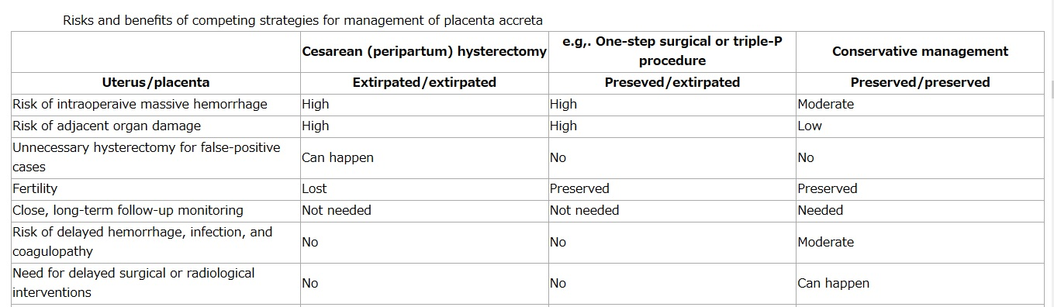
y

Slide 27
Antenatal Management
Prevention and treatment of anaemia In 3rd Trimester {risks of preterm labour and hemorrhage}: care should be tailored to their individual needs.
Home-based care: close proximity to the hospital constant presence of a companion full informed consent . attend immediately: bleeding, contractions or pain (including vague suprapubic period-like aches).
Blood availability: based on clinical factors relating to individual cases local blood bank services.
Administration of antenatal corticosteroids should be made on a patient-by-patient basis
Cervical cerclage: {reduce bleeding and prolong pregnancy} is not supported by sufficient evidence
Tocolysis: {treatment of bleeding due to placenta praevia} may be useful in selected cases. beta-mimetics: associated with significant adverse effects agent and optimum regime are still to be determined
Prophylactic anticoagulation: {can be hazardous} use on an individual basis at high risk only {Prolonged inpatient care can be associated with DVT}: mobility thromboembolic deterrent stockings adequate hydration.

Slide 28
PATIENT INFORMATION
Depends on the clinical scenario
For major placenta previa…
▪Risk of major haemorrhage 1:5
▪Risk of hysterectomy 1:10
Return to theatre rate 75:1000
Bladder injury 23:1000
For previa and previous CS…
Risk of hysterectomy is 1:3
For placenta previa accreta…
▪ Hysterectomy “very likely”

Slide 29
Delivery planning
The preferred strategy was delivery at 34 weeks without amniocentesis for placenta previa with suspected accreta, and for cases with recurrant bleeding
An expert opinion in 2010 recommended delivery for uncomplicated previa at 36 -37 weeks and 34 to 35 weeks for suspected placental invasion.

Slide 30
Suspected Placenta Praevia accreta
Reviewed by a consultant obstetrician in the antenatal period.
Risks and treatment options should have been discussed and a plan agreed, which should be reflected clearly in the consent form.
Anticipated skin and uterine incisions whether conservative management of the placenta or proceeding straight to hysterectomy is preferred in the situation where accreta is confirmed at surgery.
Possible interventions in the case of massive bleeding including cell salvage and interventional radiology.
A junior doctor should not be left unsupervised when caring for these women and a senior experienced obstetrician should be scrubbed in theatre.

Slide 31
Unexpected Placenta Accreta
preoperative preparation and the availability of a multidisciplinary team are cornerstones of the successful management of the morbidly adherent placenta.
By definition, when an unexpected placenta accreta is encountered, these resources are generally not immediately available.
An unexpected placenta accreta is often grossly obvious at the time of laparotomy. Placental tissue normally distorts the lower uterine segment and may protrude anteriorly, posteriorly, or laterally through the uterus. In contrast, occasionally bleeding may be encountered after extraction of a placenta in which gross uterine invasion was not identified.
Regardless, when a morbidly adherent placenta is suspected at the time of operation, the provider should perform a rapid assessment of the uterus, placenta, and surrounding pelvic structures.

Slide 32
Management of unsuspected placenta percreta
Delay uterine incision if things appear abnormal:
Distorted or ballooned lower segment
Blood vessels on uterine serosa
Invasion into bladder or surrounding tissue
Assess location and extent of placental invasion visually and by ultrasound
Evaluate for presence of active bleeding
Inquire about availability of resources:
blood/blood products, surgical assistance, and equipment
If patient is stable and facility is not currently prepared:
Cover uterus with warm laparotomy packs and await assistance and supplies before
proceeding with operative intervention
or
Close fascial incision, place staples in skin, and consider transfer to tertiary facility with
experience in management of percreta
If patient is actively bleeding, apply local pressure to bleeding areas (other than areas
where placental tissue is at risk), then prepare for hysterotomy for delivery followed by
surgical or conservative management of placenta percreta

Slide 33
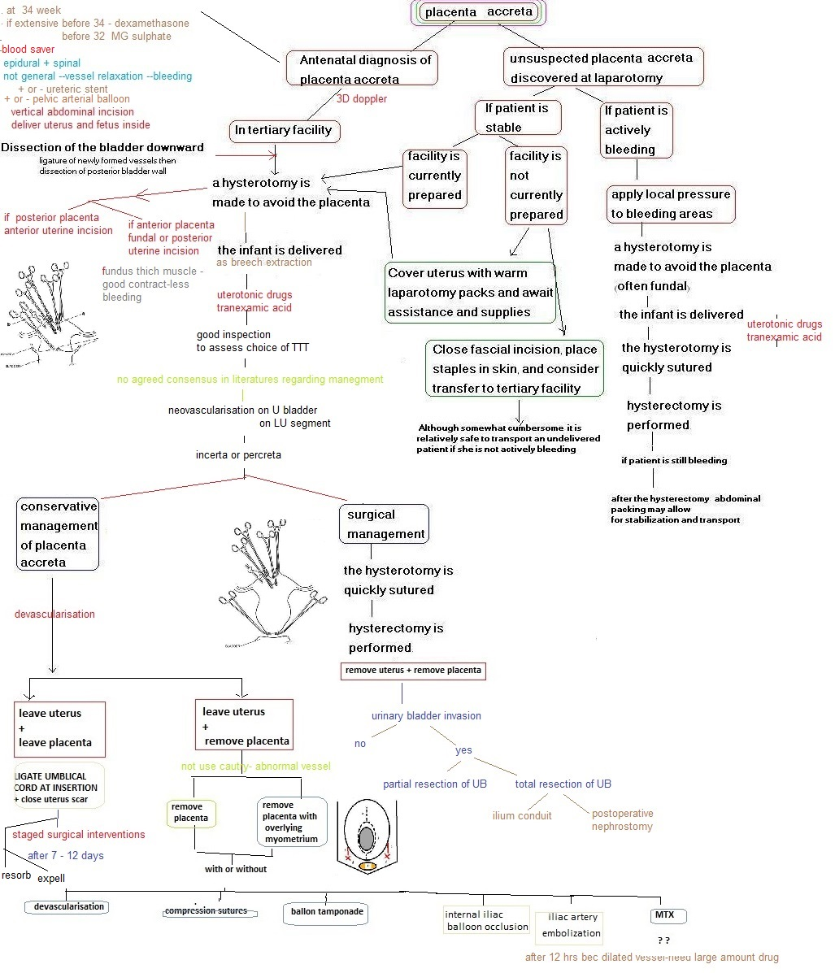

Slide 34
Preoperative preparations

Slide 35

Multidisciplinary approach
Preoperative planning is crucial to obtain an optimal outcome in the management of a patient with suspected placenta
The delivery should be performed at a tertiary center, and the management necessitates a multidisciplinary team, which may comprise
experienced obstetricians,
gynecologic oncologists,
anesthetists,
urologists,
general surgeons,
interventional radiologists, and
neonatologists.
Eller et al. reported that delivery at a tertiary center with a multidisciplinary care team decreases the risk of maternal morbidity by more than 50% among all cases of placenta accreta, and by nearly 80% risk among those with prenatally suspected placenta accreta.

Slide 36
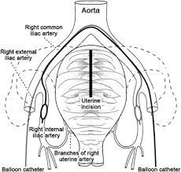
Prophylactic Embolization Or Balloon Occlusion
Iliac artery embolization, or balloon occlusion.
Embolization before performing hysterectomy may reduce the risk of intraoperative blood loss
and prophylactic devascularization may prevent the
occurrence of secondary hemorrhage
and could also accelerate placental resorption.
Overall, these uterine-sparing procedures seem to
be less effective in cases of PAS disorders

Slide 37
Ureteric Stenting
• Controversial
• Minimal morbidity in experienced hands

Slide 38
the optimal anesthetic technique for placental accreta?
When massive blood loss is expected, a complete sympathectomy (eg, spinal anesthesia) could impair the patient’s ability to cope with sudden hypovolemia, as the capacity to vasoconstrict and increase systemic vascular resistances will be limited.
Regional anesthesia with a continuous epidural technique is safe and may be appropriate for patients with placental accreta
If extensive dissection, prolonged operating time, and massive hemorrhage are anticipated, general anesthesia is commonly recommended.
When regional anesthesia was first used a reported rate of conversion to general anesthesia of about 28% to 30%

Slide 39

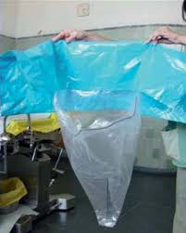
Blood Transfusion
The average blood loss at delivery is 3,000 ml
blood transfusion was necessary in 90% of patients with placenta accreta, and
40% of them required more than 10 units of packed red blood cells.
Because of a potential risk of massive hemorrhage, adequate blood products should be available and the use of cell salvage considered where available.
Transfusion of packed red blood cells and fresh frozen plasma in a 1:1 ratio is currently recommended to control massive hemorrhage.
Moreover, a 1:1:1 ratio of packed red blood cells, fresh frozen plasma, and platelets may be considered based on the current available evidence in trauma resuscitation

Slide 40
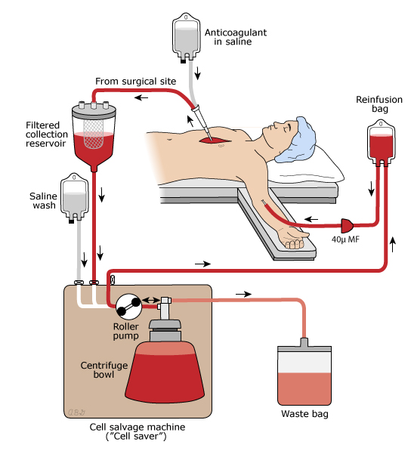
Intraoperative Cell Salvage (ICS)
The use of intraoperative cell salvage and autologous blood transfusion has become an important method of blood conservation
in 1818 when an Englishman, Rey Paul Blundell, salvaged vaginal blood from patients with postpartum hemorrhage. By swabbing the blood from the bleeding site and rinsing the swabs with saline, he found that he could re-infuse the result of the washings. This unsophisticated method resulted in a 75% mortality rate, but it marked the start of autologous blood transfusion
2-Some filter collected blood by gause filter then put it in douglas pouch in cases of ectopic pregnancy
3-Some filter collected blood by gause filter then dray by syring and inject it in empty blood bag containing citrate then reinfuse to patient in vein
4-Intraoperative cell salvage (ICS) =This is the collection and reinfusion of blood spilled during surgery.
aspirate as much of the amniotic fluid as possible before suctioning blood from the operative field
Blood lost into the surgical field is filtered to remove particulate matter and aspirated into a collection reservoir where it is anticoagulated with heparin or citrate.
The salvaged blood can be centrifuged and washed in a closed automated system , cell savers used in combination with a leucocyte depletion filter (LDF) can significantly reduce the levels of amniotic fluid and bacterial contamination
Risk from amniotic fluid , bacteria and fetal red cells .
Red cells suspended in sterile saline solution are produced, which must be transfused to the patient within 4 hours of processing. The reinfusion bag should be labelled in the operating
Contraindications = in the presence of bacterial contamination or malignancy
Massive re-infusion of salvaged red blood cells will result in depletion of platelets and clotting factors. The need for additional appropriate transfusion support e.g. platelets, fresh frozen plasma and cryoprecipitate, must be considered.
Vaginal blood can be collected efficiently with little disruption to patient management.

Slide 41
Steps involved in cell salvage:
Shed blood collection and anticoagulation:
• The system is continually anticoagulated with heparinized saline, to prevent clotting during collection or processing.
• To minimize hemolysis, blood should be aspirated from the surgical field, ideally with carefully modulated suction force and a largediameter suction catheter tip submerged in a pool of blood. These measures reduce the formation of air bubbles that increase the
or
surface area of the air-water interface, where hemolysis tends to occur.
A sterile bowl should be filled with 1000mls of sterile 0.9% intravenous
saline. Blood stained swabs should be placed in the bowl before they dry out. At the end of the case, the swabs should gently agitated to maximize red cell recovery.
Filtering
• Blood passes through a microaggregate filter (with a 20-to 40-micron effective pore size) to remove debris such as foreign matter,
fibrin, and cell clumps.
Centrifugation
• Centrifugation separates the nonerythrocyte components which are channeled into a waste container.
Washing
• isotonic wash solution is introduced to carry away remaining activated coagulation factors, free hemoglobin, heparin, and proteolytic
enzymes during further centrifugation.
• Once washing is complete, the red cells are pumped into an infusion bag for use, and air is evacuated from the bag.
End-product from cell salvage system
• A typical yield ranges from 50% to 95.8% of all RBC retrieved, with a final hematocrit typically In the 50% to 60% range
" In comparison to banked red blood cells, washed salvaged red blood cells have close to normal 2,3-diphosphoglycerate levels, and longer intravascular survival. The quality of the salvaged product reflects the collection methods and the quality of the cells collected

Slide 42
Skin Incision
In cases of invasive PAS disorders diagnosed prenatally, the exact
position of the placenta should be determined by preoperative ultrasound and the required surgical equipment for an emergent hysterectomy should available in the operating theatre
. A low transverse skin incision allowing access to the lower half of the uterus can be performed if the upper margin of the anterior aspect of the placenta does not rise into the upper segment of the uterus.
If the placenta is anterior and extending toward the level of the umbilicus, a midline skin incision may be needed to allow for a high upper-segment Transverse uterine incision above the upper border of the placenta.

Slide 43
Uterine Incision
Various modifications of the uterine incision to avoid the placenta have been reported…
- Classical incision,
- High transverse incision,
- Fundal incision,
- Fundal transverse incision

Slide 44
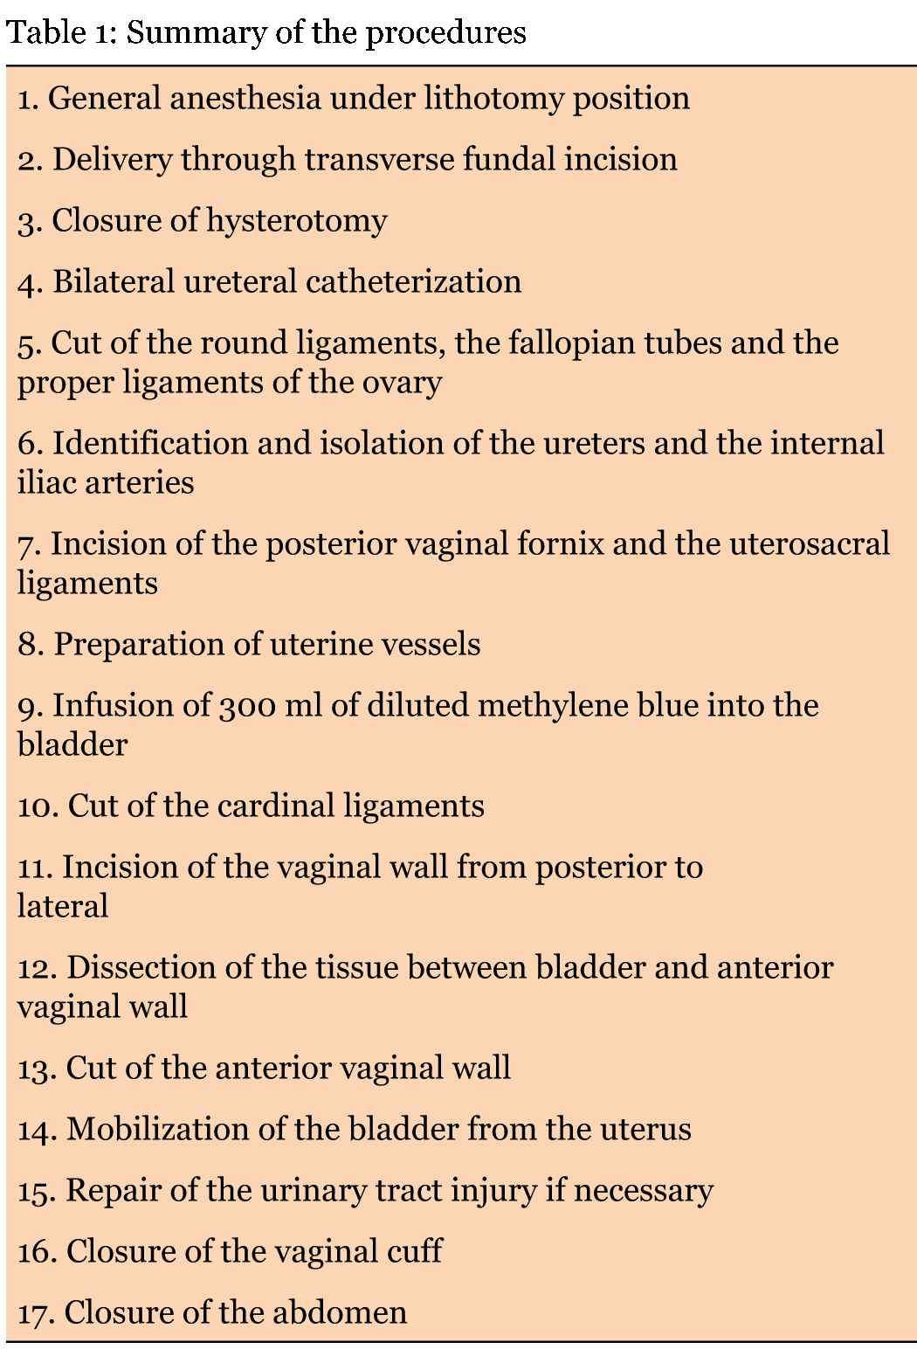
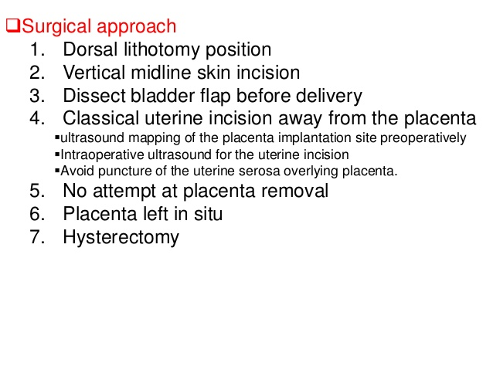
Preterm Cesarean hysterectomy without removal of placenta

Slide 45
Total Or Subtotal Hysterectomy
With the exception of upper-segment invasions,
hysterectomy for placenta accreta must be total; otherwise there is a high percentage of rebleeding in subtotal resections within the lower-segment invasions.
IF SUBTOTAL IS DONE
it is not recommended to close the peritoneum over the cervical stump, As rebleeding in these circumstances usually goes unnoticed.

Slide 46
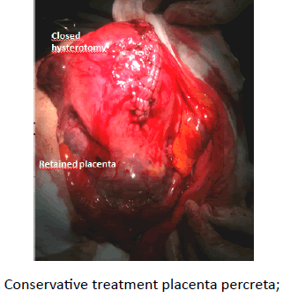
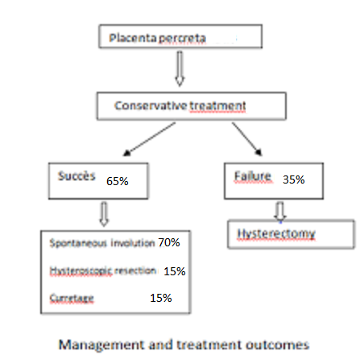
LEAVING THE PLACENTA IN SITU APPROACH (The Expectant Approach)
This approach consists of leaving the placenta in situ and waiting for
its complete spontaneous resorption. It was initially called the “conservative treatment of placenta accreta
As other conservative approaches have since been described, it is more accurate to use the terms “leaving the placenta in situ approach” or “expectant management”.
Conservative management in cases of PAS disorders was defined by the decision of the obstetrician to leave the placenta partially or totally in situ, with no attempt to remove it forcibly.

Slide 47
Options May Be Considered.
First
Is to observe closely the patient in a high dependency environment with the risk of sepsis that could complicate systemic inflammatory response syndrome (SIRS), or hemorrhage and coagulation abnormalities (disseminatedintravascular coagulopathy).
Second
Is to transfer the patient to a tertiary center where hysterectomy can be performed with the full team.
Third
Embolization may be considered if the patient experiences intermittent hemorrhage with the placenta in situ or
Fourth
An adjuvant treatment for a planned hysterectomy.

Slide 48
Medical Management
Medical management should be considered
only when the patient wishes to preserve her fertility and
when no active uterine bleeding is present.
Adequate discussion of the potential risks and benefits also is crucial.
Methotrexate (MTX) is the cornerstone of medical management, although case reports also have described
The use of antibiotics,
Uterotonics,
Surveillance with ultrasound, and
The monitoring of human chorionic gonadotropin (hCG) levels. There is no agreed-upon

Slide 49
Criteria to identify Failed Trial of Conservative Management
1.Contraindications to conservative management (lateral or deep cervical invasion)
2. Maternal request for definitive surgical management (hysterectomy)
3. Ongoing hemorrhage(no time limit-may occur hours to weeks after delivery)
4. Severe pain
5. Cardiovascular instability or signs of hemorrhagic shock (hypotension, tachycardia, decreased urine output DIC)
6. Complications(arterial injury after attempted intra-arterial balloon occlusion or embolization)

Slide 50
Surgical Management of Limited (Focal) Accreta
It has been argued that there is little clinical difference among women with total, partial, or focal accreta
since outcomes are similar.
Despite these limitations,
some women with focal abnormal placentation may be candidates for uterine-preserving therapies.

Slide 51
Exision Of Focal Myometrium With Underlying Placenta
Local resection of placental implantation site Placenta accreta and placenta increta can be safely and successfully treated, in some well-selected cases,
by resection of the placental implantation site and
repair of uterine defect.
This method provides immediate therapy, reduces blood loss and preserves fertility.
Local resection seems to be associated with fewer complications within 24 hours postoperatively compared with hysterectomy or leaving the placenta in situ

Slide 52
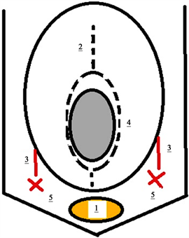
Illustrating figure showing idea of technique
1-Dissection of the bladder downward beneath the cervix.
2-Upper segment incision to deliver the fetus.
3-Bilateral uterine artery ligation.
4-elliptical incision to involve the placenta
(then closure not illustrated in figure).
5-Bilateral internal iliac artery ligation.

Slide 53
Removal Of Placenta
Forced Manual Removal
Extraction Of Placenta with curette placental site

Slide 54
Techniques For Controlling Postpartum Haemorrhage As Adjuvant To Definitive Treatment
Pharmaceutical treatment of postpartum haemorrhage is well defined (ecobolic drugs = syntocinon , methergin,misoprostol and
hemostatic drugs = tranexamic acid )
Physical methods for controlling postpartum
Manual uterine compression and massage
Packing
Balloon (balloon in all uterus , balloon in lower uterine segment )
Cooling
Vaccum Induced Uterine Tamponade = instastop
Uterine tissues eg cervical lips ( dawlatly), anterior upper uterine segment(Hennawy)
Surgical methods for controlling postpartum
Undersuturing of placental bed
Uterine compression :Manual ,uterine wrapping , External Elastic Bandage Or sutures ( All uterus , upper segment or lower segment ) , permenant or temporary
Devascularisation ( temporary or permenant)
Trans vaginal uterine artery clamping
Trans abdominal Uterine artery ligation
Ovarian vessel ligation
Hysterectomy
Logethotopulos pack
Internal iliac ligation
Arterial embolisation

Slide 55
Postpartum hemorrhage (PPH) is the most important single cause of maternal death in both developing and developed countries
Excessive bleeding occurs because of an abnormality in one of four basic processes, referred to in the “4Ts” mnemonic,either individually or in combination:
tone (poor uterine contraction after delivery),
tissue (retained products of conception or blood clots),
trauma (to genital tract), or
thrombin (coagulation abnormalities).

Slide 56
The Golden Hour” Of Resuscitation
“The golden hour” of resuscitation Golden hour is the time by which resuscitation must be initiated to ensure better survival.
“Rule of 30” -if
SBP falls by 30mmHg,
HR rises by 30beats/min,
RR ?to 30breaths/min,
Hct drop by 30%,
urine output <30ml/hr
she is likely to have lost at least 30% of her bl vol&is in moderate shock leading to severe shock.
Shock index-SBP/HR. normal value-0.5-0.7. with significant hge -0.9-1.1.better indicator for early acute bl loss.

Slide 57
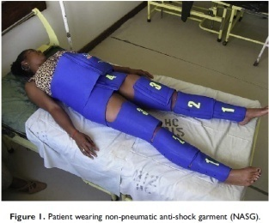
HAEMOSTASIS Algorithm
H- ask for help
A- assess (vitals, blood loss) & resuscitate
E - Establish etiology(tone,tissue,trauma,thrombine)
-Ecbolics (syntometrine,ergometrine)
-Ensure availability of blood
M - massage the uterus
O – oxytocin infusion & prostaglandin
S- shift to operating theatre
Bimanual compression
non or Pneumatic anti- shock garment
T- Tissue & trauma to be excluded
A-apply compression sutures
S-systematic pelvic devascularisation
I -interventional radiology
S-subtotal/total hysterectomy

Slide 58
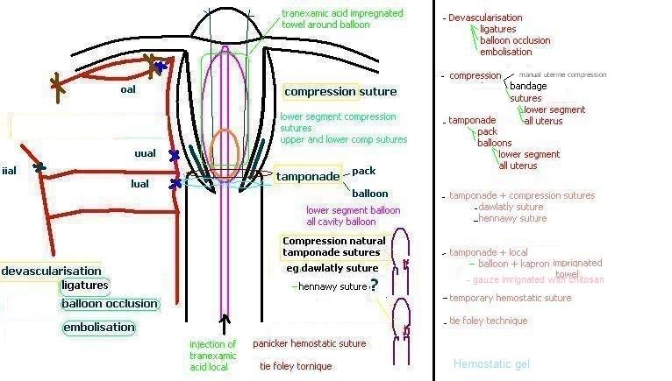

Slide 59
Pharmaceutical treatment
Ecobolic drugs = syntocinon , methergin,misoprostol
And
Hemostatic drugs = tranexamic acid

Slide 60
Stepwise Administration of uterotonic drugs
starting with intravenous oxytocin,
following with intramuscular Methylergometrin and
as last option prostaglandine derivates as prostaglandine F2, E2 or misoprostol.
In hypertensive patients , methylergometrin should be avoided,
as it should be done with prostaglandins in asthmatic women.

Slide 61
Physical methods
Aotic Compression
Packing
Balloon
Cooling
Vaccum Induced Uterine Tamponade = instastop
Uterine tissues eg cervical lips ( dawlatly), anterior upper uterine segment(Hennawy)

Slide 62
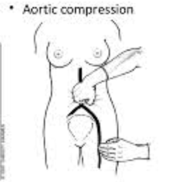
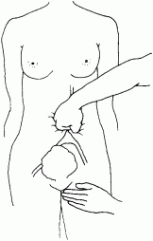
Aortic Compression
If there is a delay in obtaining assistance from such an expert, direct compression of the aorta against the spinal column can reduce bleeding by ∼40% and this can be life-saving in some cases.

Slide 63
Uterine Packing
It is a cost effective, quick and safe procedure to manage and prevent primary PPH during cesarean delivery.
Uterine packing is of benefit in achieving hemostasis particularly in cases of post partum hemorrhage due to low-lying placenta previa/accreta associated with lower segment bleeding conserving the uterus in women with cesarean delivery.

Slide 64
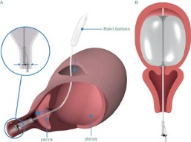
Foley's Catheter Balloon Tamponade
Intra-operatively; all patients were given ecbolic immediately after delivery of the fetus (10 IU oxytocin intramuscular).
The patients who did not respond to initial measures (direct uterine massage and ecbolic) were subjected to further management.
The 2-way Foley's catheter balloon was inserted vaginally into the uterine cavity. The balloon was positioned to fit the lower uterine segment of the uterus and inflated with 60 mL of saline.
We applied gentle traction to confirm that the 2-way Foley's catheter balloons were firmly fixed in the lower uterine segment and controlled the placental bed bleeding. The incision of the cesarean section was carefully sutured in treated patients with Vicryl R 1–0 without including the balloons. All cases received broad-spectrum antibiotic systematically used just before the operation and two days after. The blood drainage was collected from 2-way Foley's catheter balloons through the collecting bag. The 2-way Foley's catheter balloons were removed gradually after 24 hours of the operation.

Slide 65
Uterine Cooling
Smooth muscles that cooling does in fact cause contraction of the muscle
Immediately following delivery of the fetus the uterus will be externalized in the usual fashion and the body of the uterus cephalad to the hysterotomy incision will be wrapped in sterile surgical towels saturated in sterile, iced normal saline.
These towels will come from a sterile cooling pot set to 30 degrees Fahrenheit.
Iced saline-soaked towels will be kept in place for a minimum of 5 minutes and replaced at the discretion of the attending obstetrician until the hysterotomy is closed and the uterus is replaced into the patient's abdomen.

Slide 66
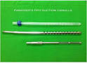
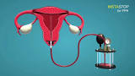
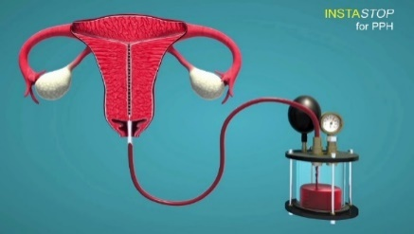
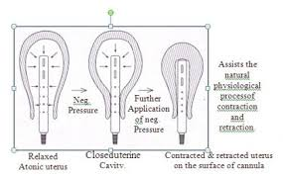
Vaccum Induced Uterine Tamponade = instastop
= A specially made stainless steel or plastic cannula of 12mm in diameter and 25cm in length with multiple holes of 5mm diameter at the distal 7cm of the cannulla was introduced into the uterine cavity through the vagina to reach the fundus.
=The cannulla is connected to a suction apparatus and a negative pressure of 700mm mercury was produced.
=The negative suction resulted in sucking out all the blood collected in the uterine cavity. The quantity of blood sucked was 50 to 300 ml. When the collected blood was completely sucked out, the bleeding ceased.
= The inner surface of the uterine cavity got strongly sucked by the cannulla. All the bleeding vessels including arterioles and sinusoids got
sucked into the holes of the cannulla, thereby mechanically closing them. The bleeding points are permanently closed due to the clot formation within 30 to 40 minutes.
=Then the cannula was taken out slowly after releasing the suction

Slide 67
Tissue Tamponade techniques Compression natural tamponade sutures
The successful use of compression sutures, using the cervix as a natural tamponade by inverting it into the uterine cavity and suturing the anterior and/or the posterior cervical lips into the anterior and/or posterior walls of the lower uterine segment
Dawlatly Suture
Modified Dawlatly suture (HS Hani Salama suture)

Slide 68
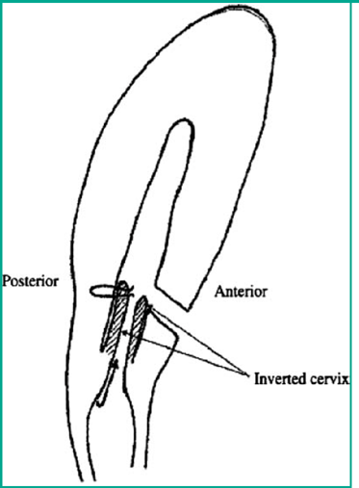
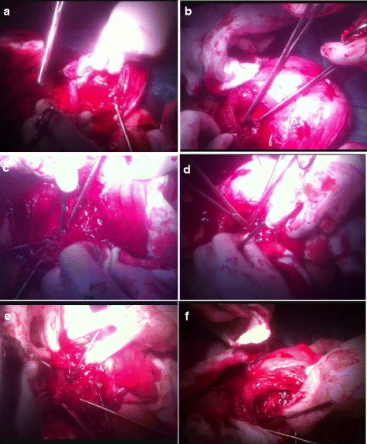
Dawlatly suture
If the cervix is not fully dilated, is to invert the lower segment upon itself before suturing it, thus compressing the bleeding surfaces without occluding the uterine cavity
The cervix as a natural tamponade in postpartum hemorrhage caused by placenta previa and placenta previa accreta
by inverting the cervix into the uterine cavity and suturing the anterior and/or the posterior cervical lips into the anterior and/or posterior walls of the lower uterine segment.
If the bleeding originated primarily from the anterior portion of the lower uterine segment, the surgeon introduced his/her hand through the uterine incision into the lower uterine segment until it touched the cervix. A long Allis forceps was passed through the uterine incision and used to grasp the anterior lip of the cervix, pulling the cervix upwards into the uterine cavity. An assistant was sometimes needed to elevate the cervix upwards from the vaginal aspect. The anterior lip of the cervix was then sutured to the anterior wall of the lower uterine segment using two or three simple interrupted absorbable stitches (Vicryl or Vicryl rapide no. 0).
If the placenta was implanted posteriorly and the bleeding areas were mainly from the posterior wall of the uterus, the same procedure could be repeated using the posterior lip of the cervix, which could then be sutured to the posterior wall of the lower uterine segment. A Hegar dilator was inserted in a retrograde manner from the abdominal aspect to ensure patency of the cervical canal during the suturing process.

Slide 69
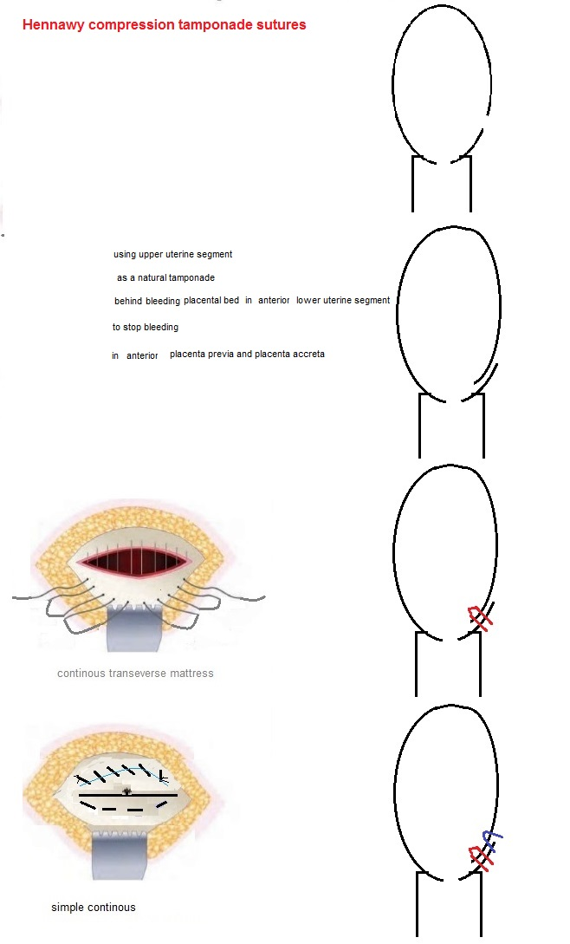
Hennawy Compression Tamponade Suture

Slide 70
Oversewing Of The Implantation Site

Slide 71
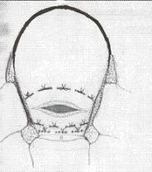
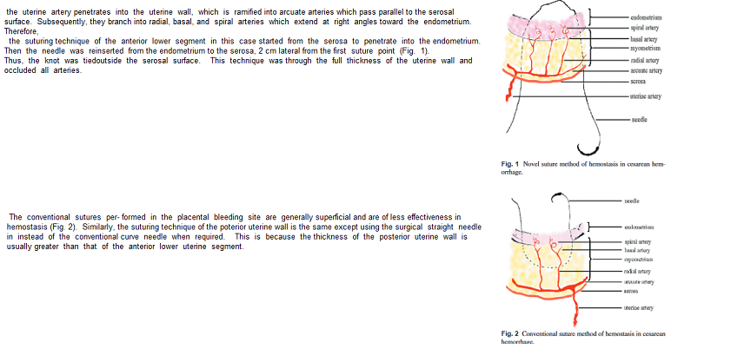
Multiple interrupted sutures of full thickness uterine wall in a circle
Oversewing of entire full thickness suturing of anterior uterine wall ( anterior or posterior wall )
Around placental site bleeding
Multiple stutures with 1-0 chromic cat were applied at bleeding sites
The knots were tied outside the serosal surface
The sutures began at the most superior portion of the lower uterine segment and progressed inferiorly
Using interrupted 2-3 cm sutures at 1 cm intervals in a circle around around bleeding area

Slide 72
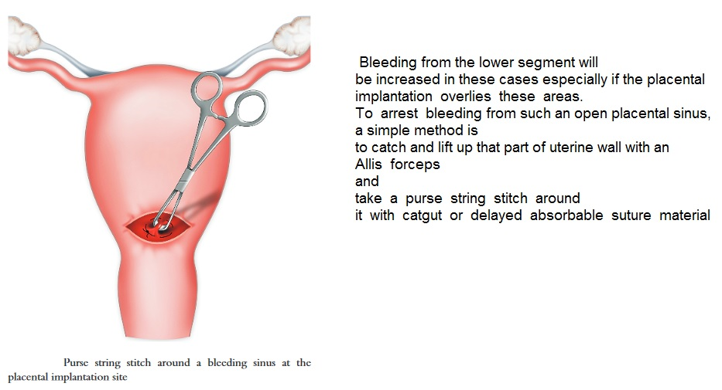
Purse String Stitch

Slide 73
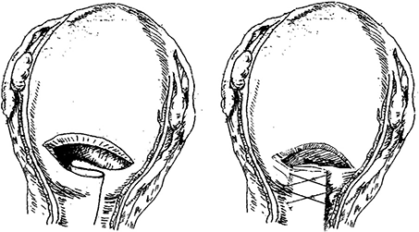
Plication of the friable lower uterine segment
Plication of the friable lower uterine segment from the anterior wall not from inside, this would stopped bleeding from inside completely
Either with excision of anterior pathological lower uterine segment which had been invaded by trophoblastic tissue
or without plication from outside rendered the thin friable lower uterine segment into normal thick coapted one.
Plication was started away from the uterine artery to avoid formation of hematoma and plication was from side to side and from up and downward to reinforce the lower segment making it very thick and to avoid further complications.
Gel foam was inserted in retrovesical space and closure of visceral peritoneum after good homeostasis was done

Slide 74
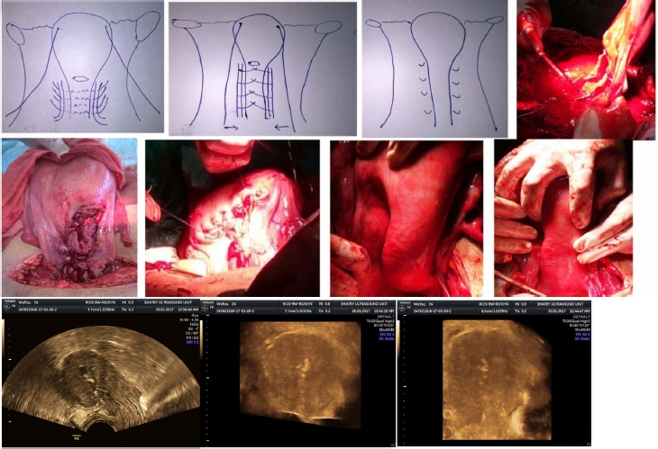
Multiple interrupted uterine transverse compression sutures with uterine artery ligation
the suture starting from below and going up where the suture go through the broad ligament from front lateral to uterine vessels to back then going front medial to uterine vessels then plicating the lower segment at the same level to the other side where the other uterine vessels are ligated in the same suture.
Then this is repeated at higher level at two-three cm interval till reaching the uterine incision or till the oozing stopped from pooling in the lower segment with ballooning (

Slide 75
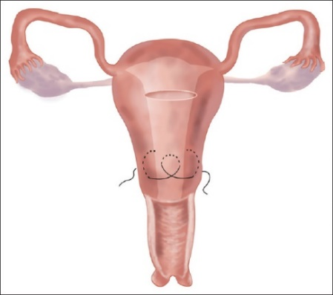
Folding Sutures
Put tourniquet around lower uterine segment
Folding sutures were made in lower uterine segment
The folding sutures started from one side of the lower uterine segment to the other. No. 1 chromic catgut suture was used to puncture the uterus posterior wall vertically to the anterior wall from the right lateral border of the lower uterine segment. The suture was pulling horizontally to the left for 2-3 cm. The catgut was fed posteriorly and vertically to enter the uterine cavity. The suture was passed backward approximately 1.0-1.5 cm and emerged at the anterior wall at the same level as the entry point. The catgut was pulled moderate tension and was passed in the same fashion toward the left for 2-3 cm. The suture was then passed over vertically to the posterior wall on the left border of the lower uterine segment.
The two lengths of catgut were pulled to achieve compression. The cervical canal was checked open
Before the knot was made from the back.
The tourniquet then was removed in time to observe bleeding from the uterine incision.
Other folding sutures could be performed either above or below the previous sutures until the bleeding was well-controlled.
The uterine incision was then closed in the normal way. Uterine arteries ligation may be carried out before folding sutures if necessary.

Slide 76
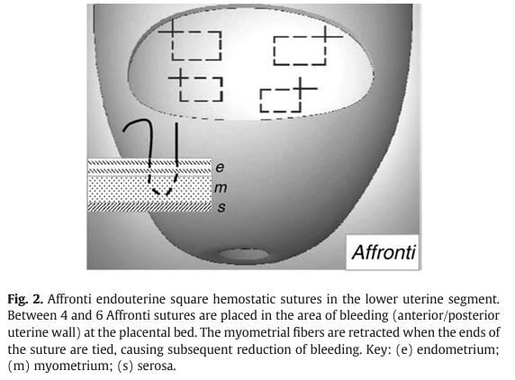
Affronti’s Sutures
Multiple square endouterine hemostatic sutures (Affronti’s Sutures)
Their application
on the anterior uterine wall
or posterior uterine wall was related to the prevalent site of bleeding;

Slide 77
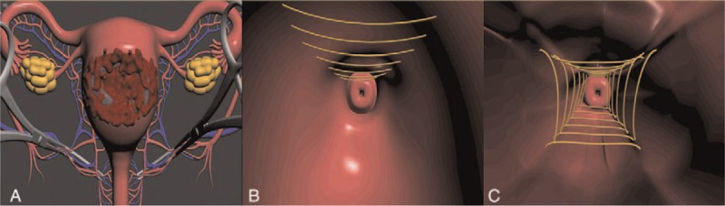
Standard Multifaceted Spiral Suture ( MSS) -- the lower uterine segment procedure. -- A. Bilateral clamping of uterine arteries: special atraumatic vascular clamps (SHA's clamps) are fixed on each side of the uterus to control blood flow via the uterine arteries until the bleeding situation has been addressed and uterus sutured. --B. A continuous running suture is made inferosuperiorly, starting from the internal cervical os (from the cervical area towards the uterine cavity) until the bleeder site has been surpassed by 1 cm. --C. The lower uterine segment can be divided into 4 areas, namely: anterior, posterior, left, and right. Once a particular area has been sutured, the bleeding situation is evaluated . After assessment, we have noticed that 1 to 3 areas typically require suturing, and if need be, all 4 areas.

Slide 78
Compression
Manual External Uterine Compression
Fundal massage
lower uterine segment compression
Bimanual uterine compression
Butterfly PostPartum Device
Uterine wrapping
External Elastic Uterine Bandage
Compression Sutures
- All uterus , upper segment or lower segment ) ,
- Permenant or temporary
- longitudinal , transverse

Slide 79
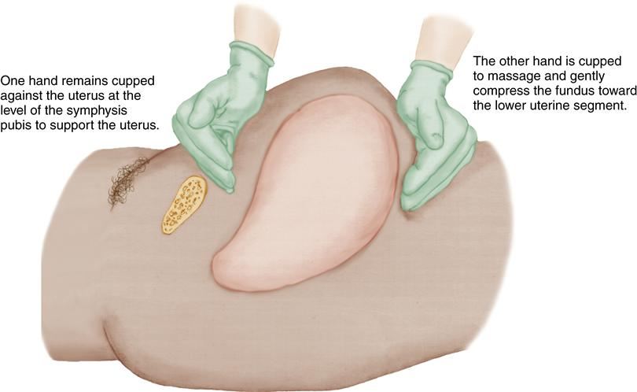
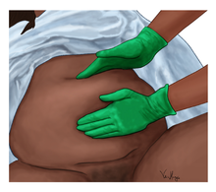
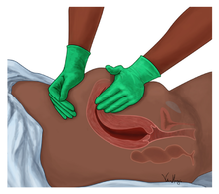
Uterine Fundal Massage
Clots that may have accumulated in the uterine cavity interfere with the ability of the uterus to contract effectively. They are expressed by applying firm but gentle pressure on the fundus in the direction of the vagina. It is critical that the uterus is contracted firmly before attempting to express clots
Pushing on a uterus that is not contracted could invert the uterus and cause massive hemorrhage and rapid shock

Slide 80
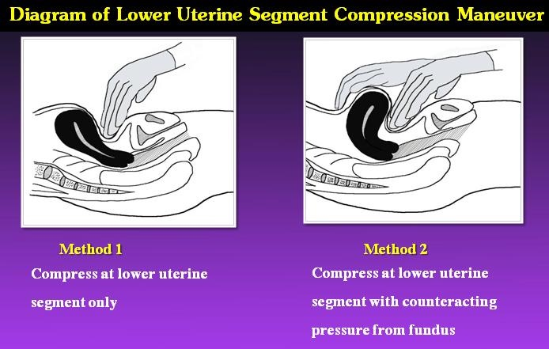
Lower Uterine Segment Compression

Slide 81
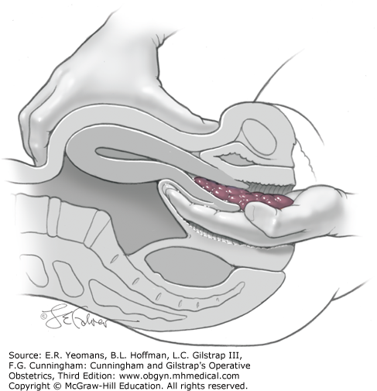
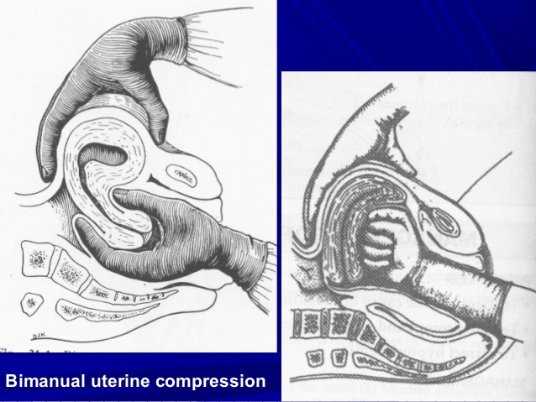
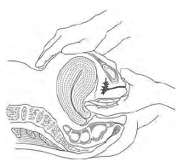
Bimanual Uterine Compression
Bimanual compression,with one hand
made into a flat in anterior or posteriot fornix
or a cup
or a fist
in the vagina and the other compressing the uterus using the other hand to press downwards

Slide 82
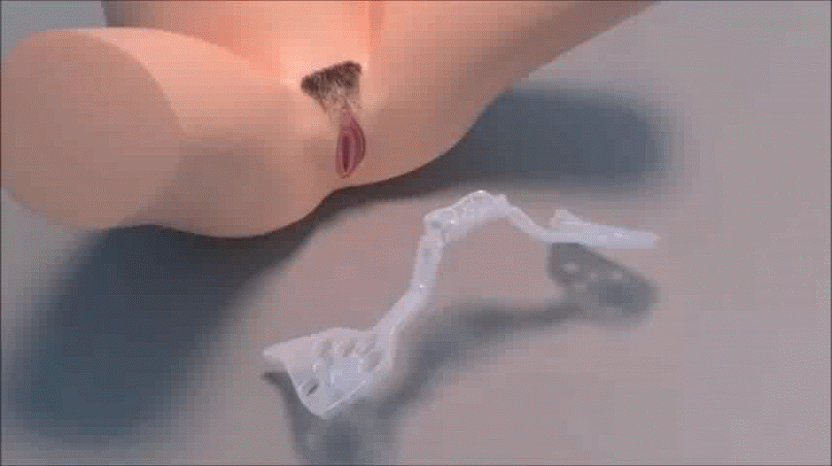
Butterfly PostPartum Device
This is the first device designed to replicate BMC while being less invasive.
It could potentially be an effective form of PPH management,
while also diagnosing the source of the bleeding

Slide 83
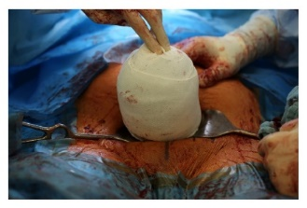
Uterine Wrapping
the uterus was exteriorized and wrapped with a white, sterile bandage (size 10 centimeters × 5 meters) concentrically from the fundus to the isthmocervical segment.
In cases with long ovarian ligaments, the ovary was put aside and was not included into the wrapping.
If inclusion of the ovary could not be avoided, slightly less wrapping was performed in the region of the ovary and the ovarian ligaments in order to maintain ovarian blood supply.
This was also important with intention to preserve blood flow of the fallopian tubes and the infundibulopelvic ligaments.
The total wrapping procedures took about 30 seconds each. If the uterus was considered well contracted by clinical evaluation (palpation of a good uterus tone and less bleeding observable)
The bandage was removed and the surgical procedure completed

Slide 84
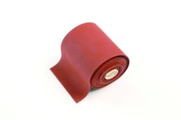
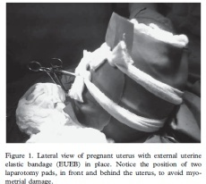
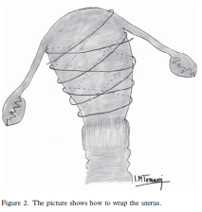
External Elastic Uterine Bandage
It is a new approach to control heavy postpartum hemorrhage associated with coagulopathy
After circulatory stabilization by external aortic compression , laparotomy , identification of the source of bleeding , compression sutures were applied and intrauterine fibrin glue was administered ,
two laparotomy pads were placed in front of and behind the uterus and (to avoid possible diminished myometrial effect of the sutures ) fixed with a gauze bandage before applying the EUEB
two wraps of external uterine elastic bandage (EUEB) were placed from the uterine fundus towards the cervix.
The use of EUEB reduced the uterine volume by half, which prevented further uterine bleeding until hemodynamic and hemostatic stabilization was achieved.
Vascular replacement was performed by balanced infusion of fluids, red blood cells, plasma, cryoprecipitates and platelets Immediately thereafter ,
After hemostasis had persisted for some times
The bandage was removed , and uterus and abdomen were then closed
Application of external elastic uterine bandage resulted in hemostasis within 45 minutes after aortic compression
Hysteroscopy 6 months after the procedure showed no signs of uterine ischemia or endometrial adhesions
It is a simple tool that seems to improve hemostasis and prevent hysterectomy in heavy postpartum hemorrhage

Slide 85
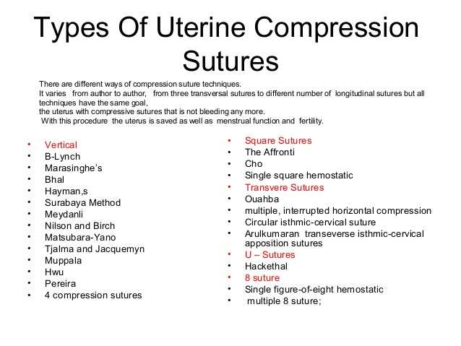
Compression Sutures
The principle is mainly the compression of the uterine body, and is basically the same for all types of compression sutures. The main differences being the figure at which the suture is applied, the numbers of longitudinal and/or transverse sutures used, and whether or not the uterine cavity is penetrated. The success rate for uterine compression sutures ranging from 68% to 100% with an overall success rate of 92%

Slide 86

3 New Removable Uterine Compression Sutures

Slide 87

Compression Sutures In The Lower Segment
Transverse , longitudinal , oblique , square or figure-of-eight are quick and simple suture techniques seems to be effective in stopping hemorrhage following complete placenta previa removal during cesarean section..

Slide 88



Vertical sutures
Hwu et al
A no. 1 chromic catgut, 40-mm curved, round suturing needle is used to make a stitch through the anterior wall of the lower uterine segment approximately 3 cm medial to the right margin of the lower segment and 2 to 3 cm above the upper margin of the cervix. The incised edge of the anterior lower segment then is pulled forward and up to expose the lower segment uterine cavity. From inside the uterine cavity, the suture is threaded through the lower segment cavity and inserted into the middle layer of the posterior wall of the lower segment 2 to 3 cm above the upper cervical margin. The needle then is directed vertically upward about 3 to 4 cm within the middle layer of the posterior wall and pulled from back to front through the uterine cavity and anterior wall of the lower segment, exiting approximately 2 to 3 cm below the uterine incision. Another no. 1 chromic catgut needle is used in the same way to place a suture approximately 3 cm medial to the left edge of the lower segment. The sutures are knotted as tightly as possible to compress the lower segment of the uterine cavity.
Parallel Vertical Compression Suture
two parallel vertical compression sutures were placed in the lower segment to compress the anterior and posterior walls of the lower uterine segment. The haemorrhage from the lower segment stopped immediately after the knots were tightened.
This parallel vertical compression suturing technique is simple, easy and effective for controlling bleeding in women with placenta praevia or accreta. The authors suggest that this technique should be tried first before other more complex procedures are undertaken [58].
Makino et al. Stepwise Double Vertical Compression Sutures
‘double vertical compression sutures’ because it has dual actions: haemostatic compression of the bleeding surface and reduced uterine blood flow

Slide 89



Muppala 2006
4 parallel vertical sutures
They were applied to the lower uterine segment without reopening the uterine incision
Using no 1 vicryl suture mounted on a curved round bodied needle
The sutures were placed anteroposteriorly just above the attachment of the uterosacral ligament each being 1.5 – 2 cm apart and the exit point is 2 cm cranial to entry point in the anterior wall

Slide 90


Oblique Suture =Ashok Anands Stitch
dd

Slide 91


Arulkumaran transeverse full thickness isthmic-cervical apposition sutures
The uterus was taken out of the abdomen.
The bladder was pushed down to prevent injury to it and to the ureters. Number 2 chromic catgut suture on a straight needle was passed through the uterus above the reflection of the bladder, about 3 cm below the lower edge of uterine incision and 2cm medial to the lateral edge of lower segment, from anterior wall through posterior wall and brought back from posterior wall through anterior wall about 1 cm medial to entry of the suture and tied anteriorly
A pair of closed artery forceps was introduced in the cervical canal through the uterine incision to prevent accidental closure of cervical canal.
Similar suture was placed on the other side of midline

Slide 92
Circular isthmic-cervical sutures
To avoid ureter and bladder injury, the bladder was reflected downward.
A silastic drain was inserted into internal and through the external os, so as to drain the uterine cavity and to keep the cervical canal open.
Firstly, at the left side of the uterus, a Vicryl number two (No..2) stitch was inserted very close to the cervix from the anterior to the posterior side of the broad ligament. The stitch was then passed posteriorly to the right side of the uterus. The needle then was inserted again very close to the cervix from the posterior to the anterior wall of the broad ligament and was tightened on the anterior uterine surface, above the reflexion of the bladder as tightly as possible.

Slide 93


CHO Square Sutures
to approximate anteriorand posterior uterine walls until no space is left in the uterine cavity. Thus, bleeding of the endometrium because of uterine atony or placentation site can be controlled by compression
An arbitrary point in the heavily bleeding area is selected and the entire uterine wall from the serosa of the anterior wall to the serosa of the posterior wall, through the uterine cavity, is sutured using a number 7
or number 8 surgical straight needle with number 1 atraumatic chromic catgut suture. Another arbitrary point 2 to 3 cm lateral above or below the first suture point is selected, and the entire uterine wall from the posterior to the anterior is sutured again. From another point in the heavily bleeding area, 2 to 3 cm lateral above or below the second suture point, we penetrate the uterine cavity walls again, this time from the anterior to posterior. Then, from the third suture point we set another point so the points form a square and penetrate the uterine walls from the posterior to the anterior. Finally, a knot is tied as tightly as possible
If bleeding is caused by uterine atony, four to five square sutures are placed evenly throughout the uterus from fundus to lower segment.
If bleeding was due to placenta accreta, with bleeding in the placental separation site, the sutures are focused in two to three areas of heavy bleeding.
By suturing a few areas with this method, the bleeding is controlled by attaching and compressing the anterior and posterior uterine walls.
If there is bleeding in the lower segment of the transverse incision site of the uterus because of placenta previa, the hemostatic multiple square sutures can be accomplished by pushing down the bladder

Slide 94
El Shazly suture
continuous or intrupted 8 compression suture with anterior and posterior bites. They resorted to this suture after failure of uterine artery ligation to stop bleeding in placenta accreta cases

Slide 95
Hemostatic cervical suturing technique for management of uncontrollable postpartum haemorrhage originating from the cervical canal.
haemorrhage originating from the cervical canal and not responding to classic management. Haemostatic cervical suturing by using no. 1 chromic catgut is a new surgical technique which approximates anterior and posterior cervical lips. It controls cervical haemorrhage by attachment and compression of the haemorrhage site of the cervical lips and lower uterine segment

Slide 96
Compression Suture In The Lower And Upper Segments

Slide 97
(Guang-Tai Li a )Longitudinal parallel compression suture
The suture apposed the anterior and posterior walls of the lower uterine segment together using an absorbable
thread A 70-mm round needle with a Number-1 absorbable thread was used. The point of needle entry
was 1 cm above the upper margin of the cervix and 1 cm from the right lateral border of the lower
segment of the anterior wall.
The suture was threaded through the uterine cavity to the serosa of the posterior wall.
Then, it was directed upward and threaded from the posterior to the anterior wall at ~1 -2 cm above the upper boundary of the lower uterine segment and 3-cm medial to the right margin ofmthe uterus.
Both ends of the suture were tied on the anterior aspect of uterus.
The left side was sutured in the same way.

Slide 98

Funnel compression suture
a funnel compression suture
the bladder was separated from the LUS and the cervix, and pushed reflectively downwards behind a retractor. A 70-mm round needle with a number 1 absorbable thread (90 cm) was inserted into the uterus 1 cm above the upper end of the cervix and 1 cm from the right lateral margin of the LUS,
From front to back, guiding the thread through the uterine cavity to the serosa of the posterior wall.
The needle was returned upwards from the posterior to the anterior wall at 2 cm above the upper boundary of LUS and 1 cm medial to the right lateral border of the uterus.
Then, the suture was † extended downwards to re-enter the cavity at 1–2 cm right lateral border of the uterus, threading through the uterine cavity and the anterior wall to emerge at a point 1–2 cm below the caesarean incision and 1–2 cm from the right lateral border of the uterus
Both ends were then tied tightly. The same stitch was repeated on the left side. By keeping an opened caesarean incision
while placing the suture we ensured that, when the LUS was closed, the angles of the incision were not sewn up and the bleeding could be examined under direct vision.
(similar in appearance to an inverted Chinese character ‘eight’, ‘ハ’).

Slide 99



Uterine folding hemostatic sutures
Fold the uterine fundus onto the anterior wall of the corpus uterus using an absorbable suture that thread tautly through the inner myometrial layer of the uterus 1–3 cm below the fundus (not entered into uterine cavity) and 1–2 cm above and below the CS incision (entered into uterine cavity 2–4 cm medal to bilateral border of the uterus).
Uterine folding hemostasis is a simple, safe and effective technique to control the atonic PPH.

Slide 100

Symbol ‘?’ suture
. The arrows indicate the direction and line of the suture; the numbers represent the puncture point and the piercing sequence. A 70 mm semicircular needle with absorbable thread is entered into the uterus 1 cm from the margin of placenta accreta at the right lower quadrant of posterior uterine wall, threading upwards within the uterine cavity and emerging 1 cm from the area of placenta accrete at the left upper quadrant of posterior wall

Slide 101
Compression Suture In All The Uterus

Slide 102

B-Lynch Following cesarean section
With a second assistant maintaining the bimanual compression
The operator displaces the bladder inferiorly
First stitch is inserted 3 cm below the lower margin of the lower segment uterine incision on the patient,s left side
Then threaded through the uterine cavity to emerge 3 cm above the upper uterine incision margin and approximately 4 cm from the lateral border of the uterus
The suture is then brought over the fundus vertically tp the posterior side , maintaining the same 4 cm distance from the lateral border
The needle is reinserted at the level of insertion of the uterosacral ligament into the uterine cavity
The needle is then brought horizontally across the cavity to the other side of the posterior uterine wall
Exiting the cavity through the wall, thus bringing the suture outside the posterior wall
The suture is again brought over the fundus onto the anterior right side of the uterus
The needle is then enters and exits the anterior wall at the corresponding points on the right side
During this process , the assistant maintains the compression as the suture is applied to ensure progressive and uniform tension to be applied as the suture compresses the uterus and to avoid slippage
The ends of the suture are under tension and tied with a double throw after the lower uterine segment incision is closed to ensure that the corners of incision are secured and included in the repair of incision without leaving any bleeding points
The first assistant then confirms that the vaginal bleeding is controlled and then abdomen is closed
B-Lynch following vaginal delivery
Hysterotomy is recommended to ensure that the uterine cavity is empty , exclude abnormal placentation , and remove the large blood clots

Slide 103

Modified B-Lynch suture
Steps of the new modified Lynch technique
Exteriorize the uterus, removal of sutures of lower seg- ment cesarean section.
The assistant stretched up the uterus,
the 1st stitch is placed 2 cm below the lower seg- ment incision and 2 cm medial to the lateral angle to come on the same side on the upper flap then cross on the fundus to the contralateral side above the uterosacral
then to the other uterosacral then to the contralateral flap in a figure of eight fashion then after tightening of
this suture the needle is passed through avascular area
in the broad ligament to the back while the tape is
passed through a window on the opposite side made by
an artery forceps to become on the posterior aspect of
the uterus.
Tightening of the transverse suture is done

Slide 104


Hayman,s Technique
Hayman,s technique are 2-4 primary vertical compression sutures are applied in a similar fashon to the B-Lynch technique except that the left and right sides are placed separately without the need to open up the uterine cavity and knots are tied over the fundus
Horizontal cervical isthmic sutures (Arulkumaran ) or Circular isthmic-cervical suture
Although quicker to perform
This method does not allow the uterine cavity to be explored

Slide 105



Symbol “&” or Pin uterine compression Suture It staples the anterior wall and posterior wall of lower uterine segment together by the tied tightly thread, and makes the uterine vessel bed or branch of two lateral uterine arteries twisted or closed so as to stop the bleeding. As other compression suture techniques

Slide 106

Marasinghe’s procedure
(A) The needle is inserted into the inner layer of the anterior wall of the lower segment and does not enter into the myometrium.
(B) The needle is inserted into the middle layer of the fundus.
(C) The needle is inserted into the inner layer of the posterior wall of the lower segment and does not enter into the myometrium.
(D) The two ends of the thread are tied on the fundus of the uterus. The procedure is then repeated on the other side.

Slide 107


Matsubara-Yano
Five penetrating sutures,
three longitudinal and
two transverse, are placed
This technique was useful for the prophylaxis of acute recurrence of uterine inversion, which was repositioned under laparotomy.

Slide 108

Bhal
After closure of cesarean section incision or after vaginal delivery
The suture was inserted at the uterine fundus , similar to Marasinghe’s procedure
Do 2 sutures
Tied the knots side by side

Slide 109
Devascularisations

Slide 110

Devascularisations
Temorary -by vascular clip (temporary atraumatic endo-vessel-clip )
- by clamping ( 4 ring forceps on both uterine and ovarian vessels; one for every vessel which was atraumatic )
- balloon inflation
- by tourniquet
- by surure
Permenant – by suture
- by embolisation

Slide 111
the female generative tract can be divided into two clearly defined areas. One involves the uterine body itself, labelled sector one (S1), and the other involves
the lower uterine segment, cervix and vagina, labelled sector two (S2)
S1 receives its blood supply mainly from the respective bilateral uterine and ovarian arteries;
S2, in contrast, is supplied by a series of subperitoneal vessels originating primarily from internal pudendal arteries,
secondarily from collaterals of the internal iliac artery and, to a lesser extent, by the uterine arteries.
Precise knowledge of the location of the area of invasion makes it possible to
plan efficient vascular control.
For example, the occlusion of the uterine arteries or ligature of the anterior
branch of the internal iliac artery in invasions in the S2 area implies a high possibility of continued bleeding, because their branches arise from the posterior division of the internal iliac artery.
This trunk connects the internal iliac system with collaterals of the external iliac and the femoral arteries; therefore, this circumstance leaves only two alternatives to control bleeding:
a proximal vascular control at the level of the infrarenal aorta or
a specific hemostatic control over tissue and prior to fascial dissection of the pelvis.

Slide 112

Underpinning vessels

Slide 113
Transvaginal Uterine Artery Clamping
About 85 % of blood reaching the gravid uterus is through the uterine arteries. These branches of internal iliac arteries join the uterus on its sides at the level of the isthmus. Anatomically, this point of entry of the uterine artery is only about 1 cm above the lateral fornix of the vagina. Hence it is possible to reach the uterine arteries through the lateral fornix in a postpartum situation when the tissues will be soft.
The tip itself is bent at right angles and is shaped like that of a sponge-holding forceps. Even when tightened to the maximum, the blades will be at a distance of about 3 mm between them so that the soft tissue of the cervix which will be between them will not get unduly compressed. One forceps is applied at 3 o’clock and the other at 9 o’clock position of the cervix. One blade goes inside the cervical canal and the other on the lateral fornix, and just before tightening the blades, the tissue is pushed up so that it will reach up to include the uterine artery of that side.
The concern is that it may occlude the ureters as well. The ureters cross the uterine arteries in the parametrium just lateral to the uterine border. So it is possible that ureters may get caught in the clamp. Since it is only a blunt compression for a few minutes, one does not have to be concerned too much about this ureteric occlusion.
The method is recommended only as a first aid while other definitive measures to stop the bleeding are being assembled. In other words this is only a more effective and easy substitute for bimanual compression of the uterus or aorta.

Slide 114




Vessels ligation
Waters – 1952 --selective uterine artery ligation (dissecting out the artery from the vein ) by chromic
O’Leary -- 1966 --Bilateral mass ligation of the asending branch of uterine arteries
(In case of caesarean section, the sutures are placed 2-3 cm below the level of uterine incision under the reflected peritoneal flap , in non CS-Suture pass At the level of vesicouterine peritoneal reflection , in bleeding is from a laceration of the uterine vessel, a similar stitch is placed both above and below the laceration )
Aleksandrov --1962 --bilateral uterine artery ligation and ligation of one of utero-ovarian anastmosis
Tsirulinkov –1975-- bilateral uterine artery ligation and bilateral ligation utero-ovarian anastmosis and bilateral ligation of arteries in the round ligaments
AbdRaboo Stepwise uterine devascularization
The steps were (1) unilateral uterine vessel ligation, (2) bilateral uterine vessel ligation, (3) low uterine vessel ligation, (4) unilateral ovarian vessel ligation and (5) bilateral ovarian vessel ligation (a ligature is placed around the utero-ovarian anastomosis )
Hypogastric artery ligation
First, the UAL ( uterine artery ligation ) success rate 94.7% is likely higher to HAL’s one 69.0% ( hypogastric artery ligation )
Second, to date, no serious adverse events have been reported following UAL contrary to HAL.
Third, UAL is clearly easier to perform and can be rapidly achieved by all physicians similarly to uterine compression suture and contrary to HAL, which requires a much longer learning curve

Slide 115


Trans abdominal uterine artery ligation
It helps to exteriorize the uterus first and push the bladder down after incising the uterovesical fold of the peritoneum. This displaces the ureter downward and laterally, reducing the risk of injury to it. At the level of the isthmus, about 2–3 cm below the level of the uterine incision for cesarean section, the suture is taken from front to back on the lateral aspect of the myometrium. One has to make sure that there is no bowel or other viscera behind, that may get injured from the needle tip. Another practical point is that if a curved needle on the needle holder is used, the tip of the needle emerging on the posterior surface of the uterus should be held with a clamp before the needle holder is released. Otherwise, there is the risk of the needle receding into the myometrium and the whole process may have to be repeated. Once the needle is pulled through, it is brought back to the anterior aspect by puncturing the broad ligament lateral to the vessels on the side of the uterus but medial to the round ligament. An avascular area to pass the needle can be easily identified by transillumination. I t is important to avoid a vessel puncture because that can lead to a hematoma formation. The lateral myometrium with the bunch of vessels, artery and vein, can then be tied

Slide 116

Ligation of Anastomosing Vessel between Uterine and Ovarian Arteries
The ovarian arteries, direct branches from the aorta, supply the ovaries and tubes and extend further to supply the cornual region of the uterus
The share of blood supplied to the uterus between the uterine and ovarian arteries will vary depending on the location of the placenta. A fundal or cornual placenta will attract more blood from the ovarian arteries.
Ligation of anastomosing branch between uterine and ovarian arteries. Tying of the anastomosing branches of uterine and ovarian arteries at the cornual region. (a) The usually seen illustration of stitch for the anastomosing branch. Blood flow to the fundus of the uterus will continue unimpeded. (b) The recommended technique. The arcade of vessels on the mesosalpinx, from just under the tube to the side of the uterus, is included so that the branches supplying the fundal region are occluded

Slide 117
Internal Iliac artery ligation
Many authors advocate its routine ligation in placenta accreta
Others reported no value for its ligation
On the other hand some authors reported severe complications such as gluteal necrosis, bladder necrosis, uterine gangrene and occasionally leg ischemia if external iliac artery is ligated by mistake

Slide 118


One hemostatic suture
Two pieces of 50cm of No. 1 vicryl held with the tip of PUL forceps. Uterus taken out, UV fold opened and the bladder pushed down. The PUL forceps with vicryl is pierced from anterior to posterior side at the centre of the cervix just above the bladder. Uterus turned anteriorly and the tip of the forceps is seen piercing through the posterior side. Tip of the forceps opened and thread pulled out- one piece to the left side and other piece to the right side and tied as tight as possible on either side. This will completely occlude blood supply to the uterus.
Now proceed with hysterectomy or uterus saving procedures.
Finally remove the haemostatic sutures and check for any bleeding.
Close the abdomen with suction drain.

Slide 119
Tourniquet
One tourniquet – isthmic = 2UA
--both = 2UA + 2OVA
Triple Tourniquet - UA
- ROVA
- LOVA

Slide 120

One tourniquet = Isthmic Tourniquet

Slide 121


One Tourniquet = 2UA + 2OVA

Slide 122




TTT = Triple Tie Technique A- 3 foley,s catheters B-one foley,s and 2 loops Or 2 Clamps
Temporary technique
3 foley,s catheters are put

Slide 123
Hemostatic Gel
Difficult accessibility and profuse bleeding prompted the consideration of alternative treatment with the topical application of hemostatic gel over the lower segment, which achieved hemostasis within minutes.

Slide 124
Combined Methods

Slide 125
Combine the compression suture with an intrauterine balloon.
The suture must be inserted first (clearly, inserting a suture after the
balloon risks puncturing it).
Bakri balloon with mastubara compression suture

Slide 126

Foley's catheter balloon and suture around
During surgery, a Foley catheter balloon containing 60–120 mL of water was used to compress the hemorrhage site and an absorbable suture was placed around the lower uterus segment to provide extra pressure on the balloon.

Slide 127

Transverse B-lynch sutures
B Lynch by making horizontal sutures passed in a vascular area in the broad ligament make more tension around and pressure in the lower segment plus ligation of uterine arteries

Slide 128

Intrauterine gauze compress combined B-Lynch uterine compression suture

Slide 129

Uterine packing with chitosan-covered gauze
Chitosan-covered gauze is a viable option in the treatment of (severe) postpartum hemorrhage. It is easy to use and requires no special training. It can be used after both vaginal and cesarean deliveries, and there are no adverse side effects. Furthermore, it is very inexpensive compared with other treatment options, making it suitable for use also in low resource-countries, where the death toll due to postpartum hemorrhage is especially high

Slide 130
Uterine packing with tranexamic acid-covered gauze
Intravenous tranexamic acid reduces bleeding in surgery, however, its effect on the risk of thromboembolic events is uncertain and an increased risk remains a theoretical concern. Because there is less systemic absorption following topical administration, the direct application of tranexamic acid to the bleeding surface has the potential to reduce bleeding with minimal systemic effects

Slide 131
Uterine Balloon Tamponade in Combination with Topical Administration of Tranexamic Acid
A profuse hemorrhage continued despite administration of uterotonics, fluid, and blood transfusion. The total blood loss was more than 5,000 mL. In each case, an intrauterine balloon catheter was wrapped in gauze impregnated with tranexamic acid, inserted into the uterus, and inflated sufficiently with sterile water. In this way, mechanical compression by a balloon and a topical antifibrinolytic agent were combined together. This method brought complete hemostasis and no further treatments were needed. Both the women left hospital in stable condition

Slide 132




(Modified UBT) uterine balloon tamponade
The combination of an intrauterine balloon catheter and wet gauze bulks larger than a balloon catheter alone and needs to be inserted into the uterus carefully and gently. Our method can be applied well to PPH after vaginal delivery but may be difficult after cesarean delivery without labor due to the lack of cervical dilation. For such cases, conventional UBT should be indicated first. The wrapping gauze should never be wound up around a catheter simply like a scroll. If that happens, the balloon would fail to expand and would eventually burst. So we recommend the way shown
only two sheets of gauze around the balloon catheter, and their ends were visible from the vagina. Therefore, gauze could be easily removed without a fear of retention. The risk of infection can be minimized by removing both the balloon and gauze within 24 hours and administering prophylactic antibiotics.

Slide 133
Steps Of Tretment

Slide 134
One-step conservative surgery for abnormal placentation (OSCS) =one operation=one-time surgery= One step procedures
when < 50% of the anterior uterine circumference was involved
Designing a one-time surgery implies solving all the
problems caused by placenta accreta at one operation.
This involves
=vascular disconnection of the invaded organs (uterus, placenta and bladder),
=correct compartment exposure of the pelvic organs (necessary for the hemostatic procedures),
=total resection of the invaded myometrium and, finally,
=uterine and vesical reconstruction

Slide 135
Two step procedure (Palacios-Jaraquemada,2013)
The first step Include leaving placenta in situ plus methotrxate injection at the operative time and follow up by weekly β-HCG level and MRI.
The second step is delayed hysterectomy (Interval hysterectomy) after 6 weeks conservation with minimal blood loss.
It had the complications of both conservative treatment and hysterectomy so it is not recommended [24,67]. Afia et al. [68] conducted a study to determine the outcome of interval hysterectomy compared to immediate caesarean hysterectomy. They found less blood loss, less visceral injuries, and better dissection in the group of delayed hysterectomy [68].

Slide 136
‘Triple-P Procedure’
A new conservative surgical technique called the ‘Triple-P Procedure’ involves
p eri-operative placental localization and delivery of the fetus via transverse uterine incision above the upper border of the placenta,
pelvic devascularization and
placental non-separation with myometrial excision and reconstruction of the uterine wall.
It has been described as a safe and effective alternative to intentional retention of the placenta or peripartum hysterectomy.

Slide 137
Post-operative follow up
The decision for intensive care unit admission was made by the anaesthesiologist. Post-operative patients requiring haemodynamic monitoring, ventilator support or extensive nursing care were admitted. All patients received thromboprophylaxis with 30 mg/day of enoxaparin (Clexane, Aventis Intercontinental, France). Utero-tonic drugs were continued within the first 24 hours.
The histopathological specimens consisted of the excision of the whole placenta, myometrium and invaded surrounding tissue (Fig. 5). A diagnosis of PP was confirmed with histopathologic examination in all cases.

Slide 138

Risk to the Mother
1. Life-threatening: Placenta accreta, if not diagnosed and managed in time can be life-threatening. It carries a mortality rate of up to 10%.
2. Loss of fertility: Hysterectomy or removal of the uterus is the treatment of this condition in the majority of the cases. This means that the mother loses all the chances of childbearing in the future.
3. Damage to other organs: There is an increased risk of bladder injury, ureteral injury, pulmonary embolism, need for ventilator use, and an increased risk of ICU admission.
4. Surgery and anaesthesia related risks

Slide 139
Risk to the Foetus
There is no effect of placenta accreta on the baby.
But associated placenta praevia may cause difficulty and delay in the delivery of the baby causing the complications related to delayed labour.

Slide 140
prophylaxis
Most logical long-term strategies
• Limit cesareans to fewest possible
• Encourage patients with 2 or 3 prior cesareans to avoid or limit future pregnancies

Slide 141
Stepwise Approach to Placenta Previa Accreta
1.Establish the diagnosis and extent of placental invasion.
2.Counsel the patients and relatives about the seriousness of the situation without frightening them.
3.Plan surgery (cesarean) as an elective procedure.
4.Arrange enough blood and blood products.
5.Ensure presence of experienced obstetrician and urologist (if obstetrician is not confident enough to tackle a potential urological injury).
6.Insert bilateral ureteric catheters and a Foley catheter in the bladder.
7.Use regional anesthesia or regional with general anesthesia for the surgery.
8.Use vertical incision on the abdomen extending above the umbilicus and classical incision on the uterus above the level of the placenta.
9.If accreta placenta is confirmed on seeing the very vascular bulge of the lower segment, decide whether to do hysterectomy without disturbing the placenta or leave the placenta and uterus in situ. Do not try manual removal.
10.If decision is to leave the placenta behind, tie the cord close to the placenta and remove the excess length of cord, close the uterus, and come out leaving the placenta in situ.
11.If the decision is for hysterectomy, apply tourniquet to both infundibulopelvic ligaments and occlude the blood flow through common iliac arteries (lower end of the aorta) with specially developed clamps. Proceed with hysterectomy, up to the level of uterine arteries.
12.By sharp dissection separate the bladder from the uterus and do a subtotal hysterectomy leaving behind part of the cervix below the level of the placenta. Avoid unnecessary separation of the bladder from the vagina.
13.Double ligate all the pedicles.
14.Remove occluding clamps and tourniquets and ensure that circulation to lower limbs is reestablished by palpating the femoral pulse.
15.Close the abdomen after leaving a wide-bore drain. Time elapsed from the time of common iliac clamps should be announced every 5 min. Try to complete the procedure in about 30–40 min. Keep the patient under close monitoring in a high dependency unit.

Slide 143
Conclusions
The incidence of placenta accreta is increasing with the increasing ceserean section rate
•Women with risk factors for placenta accreta should undergo ultrasound for antenatal diagnosis
•Women with an antenatal diagnosis of placenta accreta should be managed at a tertiary care center by a multidisciplinary team
Conservative management with placenta left in situ results in less blood loss and need for transfusion at the time of surgery, but may be associated with an increased risk of post-op infection
•Successful pregnancies are possible after conservative management of placenta accreta, but are associated with a high rate of recurrence

